Slide 1

Methods: EDA and linear regression
Luis Carlos Guevara
Faculty of Finance, Government and International Relations
2026-I

Slide 2
A Framework for Research
Research problem
Research question
Philosophical assumptions
Research designs
Positivist
Constructivist
Transformative
Pragmatic
Quantitative
Qualitative
Mixed Methods
Approaches to research
Methods for data collection, analysis, and interpretation
Innovation in research
Questions
Data Collection
Data Analysis
Interpretation
Validation

Slide 3
A Framework for Research, from the problem
Philosophical assumptions
The distinction between qualitative and quantitative is important for processes such as coding, measurement, and analysis; however, it is not a distinction that defines a research design.
Research design
Sampling
Ethics
Measurement
Analysis
Methods for data collection, analysis, and interpretation
All research designs can generate quantitative data, qualitative data, or both. Research designs should therefore not be categorised based on the type of data they might produce, because data categories are not mutually exclusive
Question
Problem

Slide 4
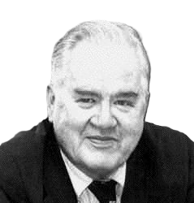

2/8/2026
What is the purpose of an Exploratory Data Analysis?
To examine the data in terms of its:
Distribution
Relationships between variables
Outliers and anomalies
John W. Tukey (1977) introduced EDA, and since then it has become standard practice for analysing datasets.
John W Tukey (1977)
Developing an EDA process evaluates data quality and supports hypothesis model building.
“Any method that examines the data without formal statistical modelling or inference is considered exploratory data analysis”.
Most EDA techniques are graphical, with only a few quantitative approaches.
Howard Seltman
EDA is a crucial step after data collection and preprocessing, where the data are visualised, plotted, and manipulated without assumptions.
Data analysis

Slide 5
2/8/2026
What is the purpose of an Exploratory Data Analysis?
1.
To maximise knowledge of the dataset, that is, to develop a thorough understanding of its structure
2.
To visualise potential relationships (direction and magnitude) between independent and dependent variables.
3.
To detect outliers and anomalies, which are values that differ significantly from the rest of the observations.
4.
To extract and create relevant variables.
5.
To develop parsimonious models, meaning explanatory models that use the smallest number of variables possible, or to identify a preliminary selection of appropriate models
Graphical
Non-Graphical
Univariate
Multi - variate
Data analysis

Slide 6



Types of Data and Graphical EDA Techniques
Data type | EDA technique
Categorical | Descriptive statistics, bar charts
Univariate continuous | Histogram, line graph
Bivariate continuous | 2D scatter plot
2‑D matrices | Heatmaps
Multivariate – trivariate | 3D scatter plot; 2D scatter plot with categorical variables; segmented scatter plots by category; boxplots by groups
Métodos cuantitativos

Slide 7
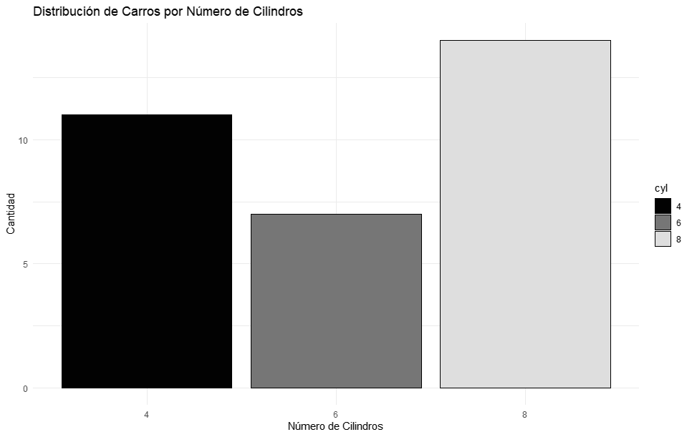
2/8/2026
Types of Data and Graphical EDA Techniques
1.
Categorical variables and counts
Freq tables
cyl_table <- table(mtcars$cyl)
print(cyl_table)
Bar plots
ggplot(mtcars, aes(x = cyl, fill = cyl)) +
geom_bar(color = "black") +
scale_fill_viridis_d(option = "magma") +
labs(x = "Número de Cilindros",
y = "Cantidad",
title = "Distribución de Carros por Número de Cilindros") + theme_minimal()
Data analysis

Slide 8
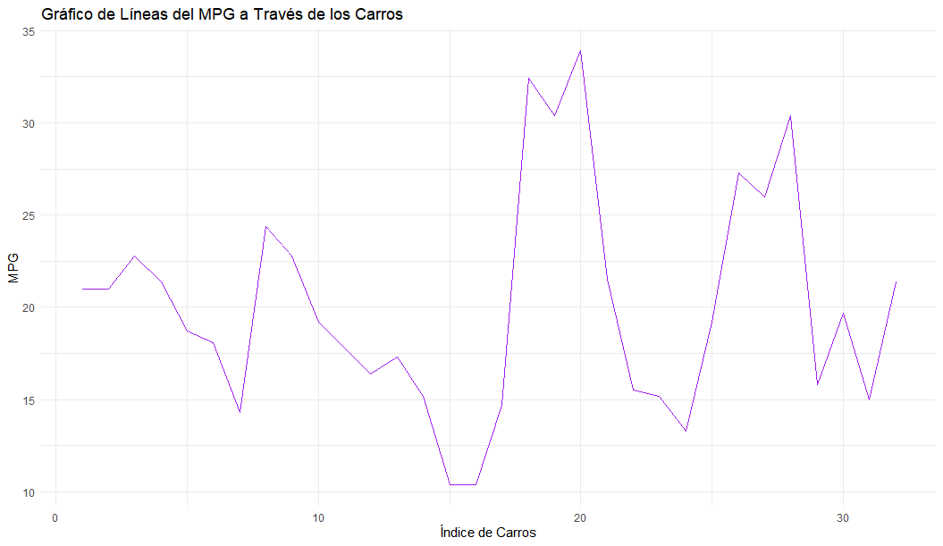
2/8/2026
Types of Data and Graphical EDA Techniques
2.
Continuous univariate
Histogram
ggplot(mtcars, aes(x = mpg)) +
geom_histogram(binwidth = 2, aes(fill = ..count..), color = "black") + scale_fill_viridis_c(option = "magma") +
labs(x = "Millas por Galón (mpg)",
y = "Frecuencia",
title = "Histograma de MPG") +
theme_minimal()
Line plots
mtcars <- mtcars %>% mutate(index = row_number())
# Gráfico de líneas del MPG a través del índice de carros
ggplot(mtcars, aes(x = index, y = mpg)) +
geom_line(color = "purple") +
labs( x = "Índice de Carros",
y = "MPG",
title = "Gráfico de Líneas del MPG Vs Carros") +
theme_minimal()
Data analysis

Slide 9
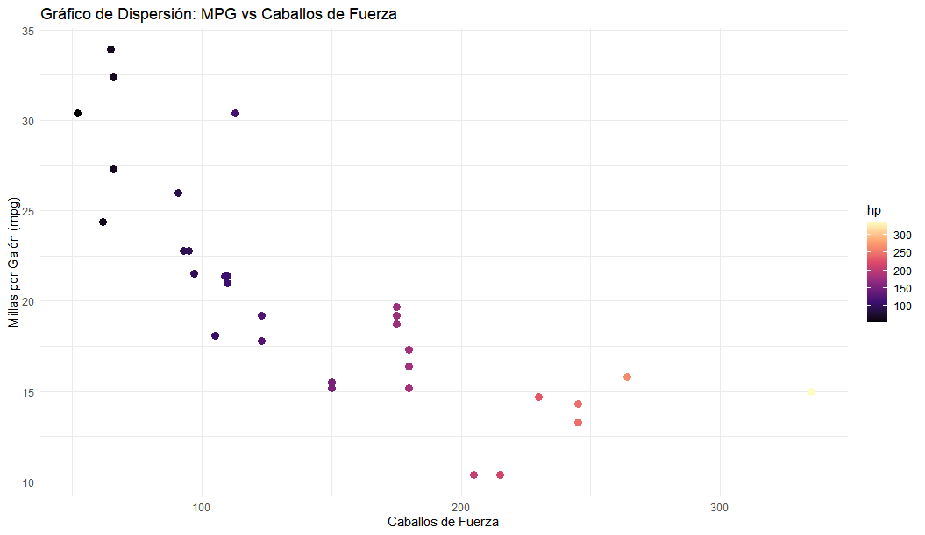
2/8/2026
Types of Data and Graphical EDA Techniques
3.
Continuous bivariate
Scatter plot
ggplot(mtcars, aes(x = hp, y = mpg)) +
geom_point(size = 3, aes(color = hp)) +
scale_color_viridis_c(option = "magma") +
labs( x = "Caballos de Fuerza",
y = "Millas por Galón (mpg)",
title = "Gráfico de Dispersión: MPG vs Caballos de Fuerza") +
theme_minimal()
Correlation matrix
# Selecciona variables continuas para la correlación: MPG, disp, HP y peso (wt)
numeric_vars <- mtcars %>% select(mpg, disp, hp, wt)
corr_matrix <- round(cor(numeric_vars), 2)
melted_corr <- melt(corr_matrix)
# Mapa de calor usando la paleta magma
ggplot(melted_corr, aes(x = Var1, y = Var2, fill = value)) + geom_tile(color = "white") +
scale_fill_viridis_c(option = "magma", direction = -1) +
labs(x = "", y = "", title = "Mapa de Calor de Correlación para Variables Seleccionadas de mtcars") +
theme_minimal()
Data analysis

Slide 10
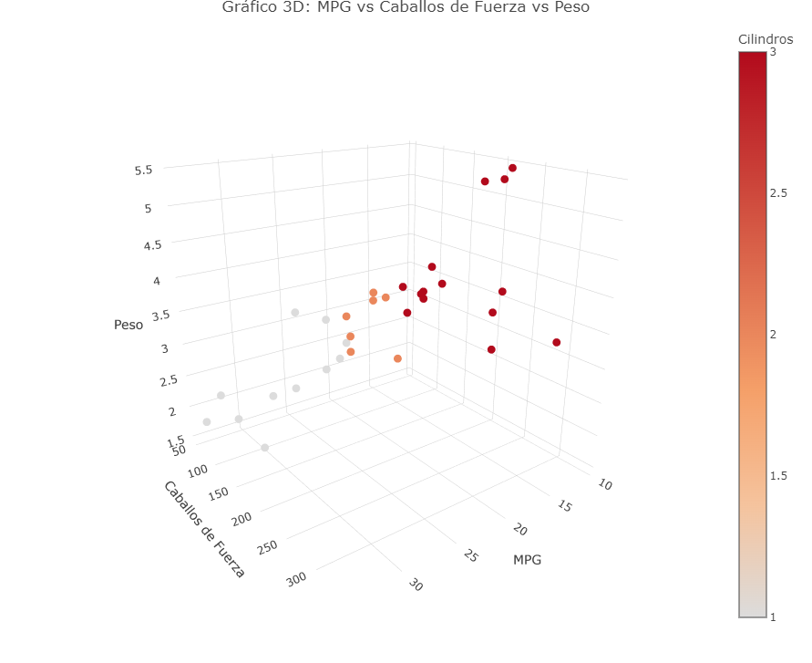
2/8/2026
Types of Data and Graphical EDA Techniques
4.
Continuous multivariate
3D Scatter plot
p3d <- plot_ly(mtcars,
x = ~mpg,
y = ~hp,
z = ~wt,
type = "scatter3d",
mode = "markers",
marker = list(size = 5,color = ~as.numeric(cyl),
colorscale = "Magma",
colorbar = list(title = "Cilindros"))) %>%
layout(title = "Gráfico 3D: MPG vs Caballos de Fuerza vs Peso", scene = list(xaxis = list(title = "MPG"),
yaxis = list(title = "Caballos de Fuerza"),
zaxis = list(title = "Peso")))
Data analysis

Slide 11
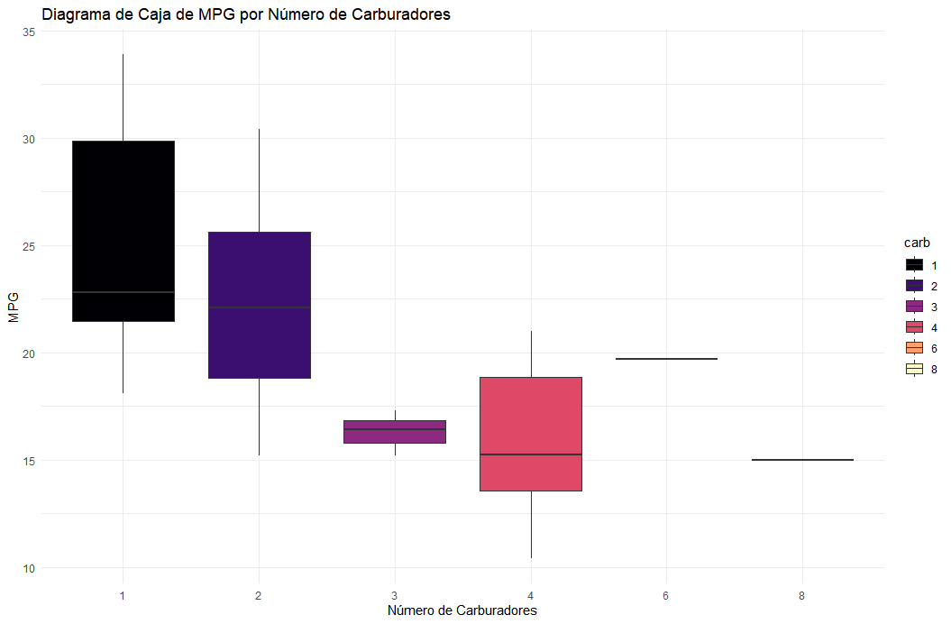
2/8/2026
Types of Data and Graphical EDA Techniques
4.
Continuous multivariate
Box plots
ggplot(mtcars, aes(x = carb, y = mpg, fill = carb)) +
geom_boxplot() +
scale_fill_viridis_d(option = "magma") +
labs(x = "Número de Carburadores",
y = "MPG",
title = "Diagrama de Caja de MPG por Número de Carburadores") + theme_minimal() ggplot(mtcars, aes(x = carb, y = index, fill = carb)) +
geom_boxplot() +
scale_fill_viridis_d(option = "magma") +
labs(x = "Número de Carburadores",
y = "MPG",
title = "Diagrama de Caja de MPG por Número de Carburadores") + theme_minimal()
Data analysis

Slide 12
Types of Data and non-graphical EDA Techniques
Given an X numerical variable
Function | Description
summary(x) | General description of a vector
max(x) | Max value
mean(x) | Average value
median(x) | Median value
min(x) | Min Value
sd(x) | Standard deviation
var(x) | Variance
IQR(x) | Interquartile range
Métodos cuantitativos

Slide 13
2/8/2026
Types of Data and non-graphical EDA Techniques
1.
Continuous univariate
Frequency tabulation for categories.
Used for categorical variables. It consists of constructing a table that contains the count and the proportion (or frequency) of the data corresponding to each category.
The median is the central value in an ordered list of data. Because the median is less affected by extreme values and outliers, it is considered more “robust” than the mean.
Mode
Mean
Median
Central tendency, dispersion, and distributional shape (skewness, kurtosis). These rely on sample statistics to express the characteristics of a sample using a limited set of parameters, which serve as estimates of the corresponding population parameters.
Measures of central tendency (arithmetic mean, median, mode)
Measures of dispersion (variance, standard deviation, interquartile range, minimum and maximum values)
Measures of distribution (skewness, kurtosis)
Mode
Median
Mean
Data analysis

Slide 14
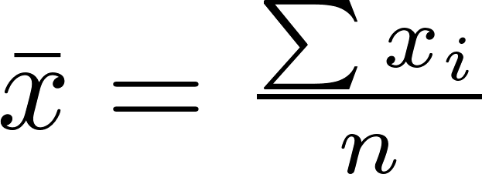
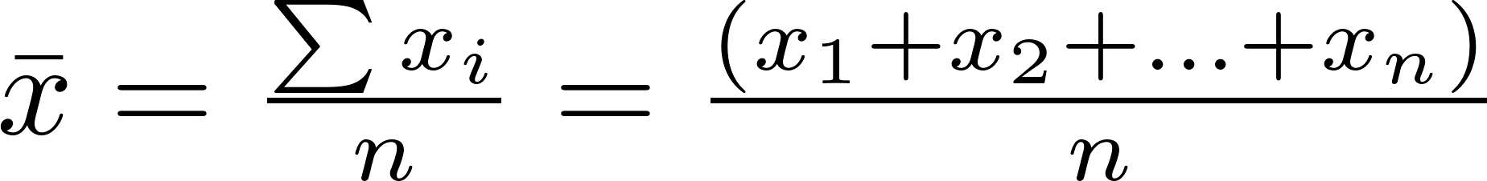
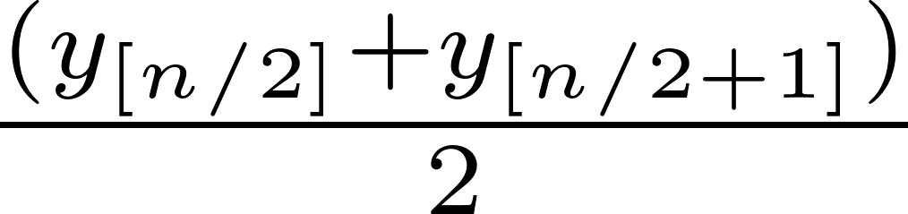
2/8/2026
Types of Data and non-graphical EDA Techniques
Measures of Central Tendency The arithmetic mean is the sum of all observations divided by the number of values. The median is the central value in a list containing all observations ordered from smallest to largest.
Sample mean
Mode
Mean
Median
Mode
Median
Sample median
Mean
To determine the median of a sample with n observations:
Order the data from smallest to largest.
If n is odd, the median is the central observation.
If n is even, the median is the mean of the two central observations.
Data analysis

Slide 15

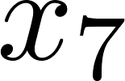
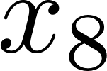
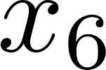
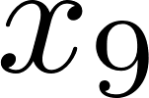
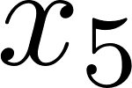
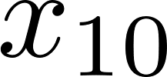


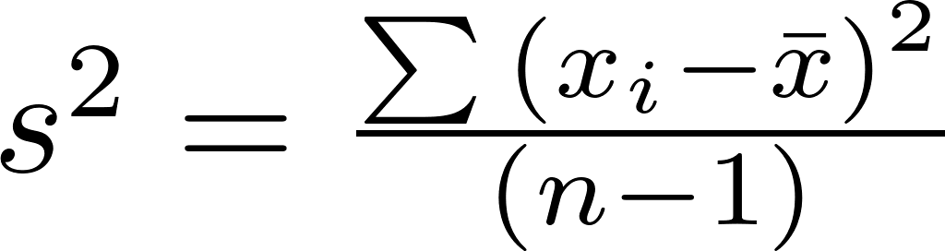
2/8/2026
Types of Data and non-graphical EDA Techniques
Variance When variance is calculated using the entire population, the result is obtained by dividing the sum of squares by the population size.
The sample formula for variance conventionally uses n−1 in the denominator to achieve the property of unbiasedness.
This means, approximately, that when calculated for many different random samples from the same population, the average of the sample variances should coincide with the corresponding population parameter.
Data analysis

Slide 16
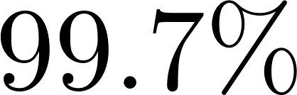
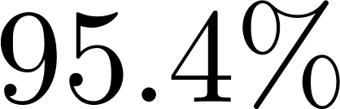
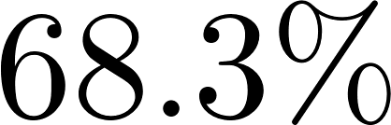
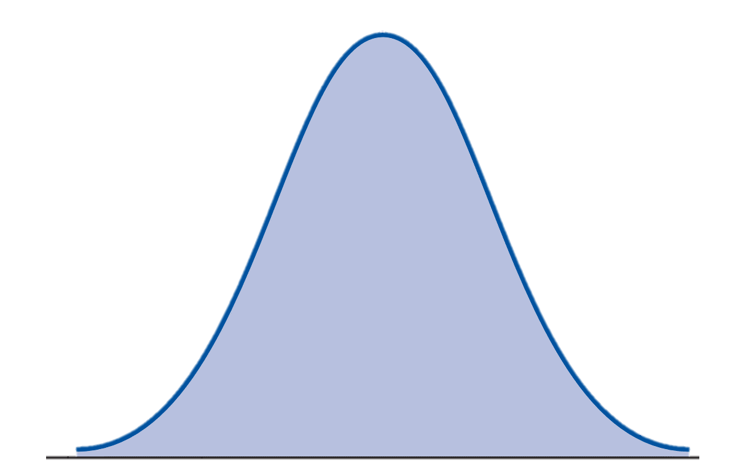
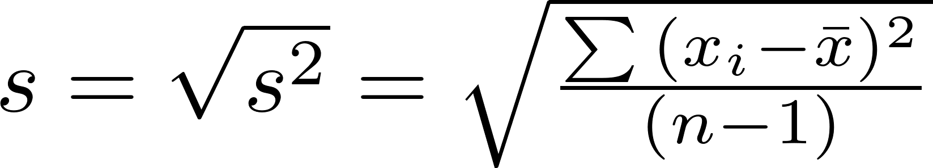
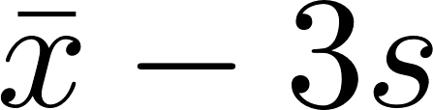
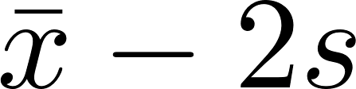
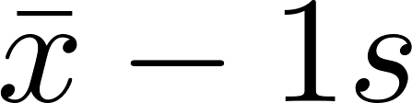
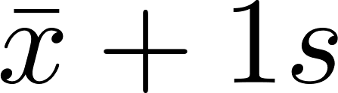
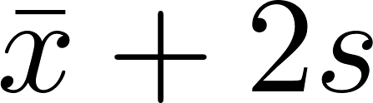
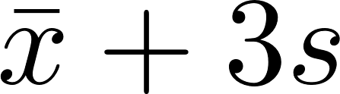
2/8/2026
Types of Data and non-graphical EDA Techniques
Standard Deviation The standard deviation is the square root of the variance. Because of this, it has the same units as the original data, which makes it more interpretable.
The sample standard deviation is commonly represented by the symbol s.
For a theoretical Gaussian distribution, the mean ± 1, 2, or 3 standard deviations encompasses 68.3%, 95.4%, and 99.7% of the probability density, respectively. This is known as the empirical interval.
Data analysis

Slide 17
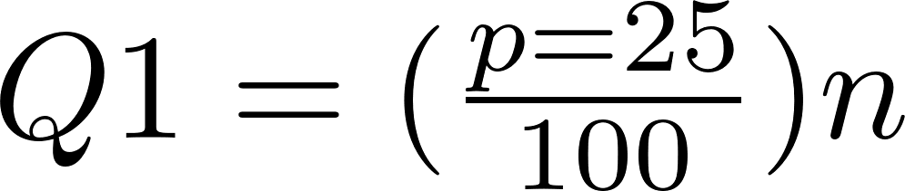
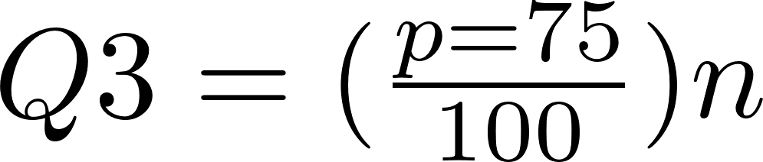

2/8/2026
Types of Data and non-graphical EDA Techniques
Interquartile Range (IQR) The interquartile range (IQR) is calculated using the limits of the data located between the first and third quartiles. The IQR is a more robust measure of dispersion than the variance or the standard deviation and should therefore be preferred for small or asymmetric distributions.
For symmetric distributions (not necessarily normal) and N > 30, results should be expressed as mean ± standard deviation.
For asymmetric distributions, N < 30, or when there is evidence of outliers, results should be expressed as median ± IQR, as these are more robust.
IQR
Position | 1 | 2 | 3 | 4 | 5 | 6 | 7 | 8 | 9 | 10 | 11 | 12
Valye | 38,077 | 38,353 | 38,366 | 39,682 | 40,677 | 40,687 | 40,715 | 42,362 | 44,165 | 44,355 | 45,054 | 48,360
25%
25%
25%
25%
Q1
39,024
Q2
40,701
Median
Q3
44,260
50%
The difference between Q1 and Q2 indicates the dispersion of the central 50% of the values
Data analysis

Slide 18
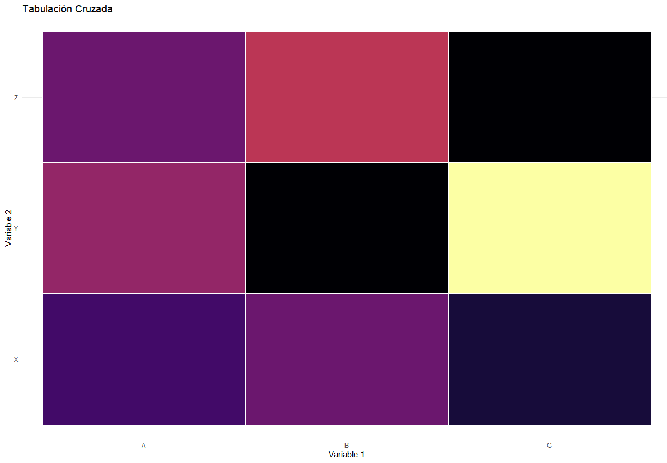
2/8/2026
Types of Data and non-graphical EDA Techniques
Cross tabulation Cross‑tabulation represents a bivariate non‑graphical exploratory data analysis (EDA) technique. It is an extension of tabulation and is applicable to categorical data as well as quantitative data with only a few variables.
For two variables, a two‑way table is constructed with:
Column headers corresponding to the levels of one variable, and
Row headers corresponding to the levels of the other variable.
The table is then filled with the counts of all individuals who share each pair of levels.
Cross tabulation
# Crear tabla de tabulación cruzadatabla_cruzada <- table(datos$Variable1, datos$Variable2) # Convertir tabla cruzada a un data frame tabla_cruzada_df <- as.data.frame(tabla_cruzada) # Agregar columna de frecuencia relativa tabla_cruzada_df$FrecuenciaRelativa <- tabla_cruzada_df$Freq / sum(tabla_cruzada_df$Freq)
Var1 | Var2 | Freq | Relative frequency
A | X | 10 | 0.1
B | X | 11 | 0.11
C | X | 9 | 0.09
A | Y | 12 | 0.12
B | Y | 8 | 0.08
C | Y | 18 | 0.18
A | Z | 11 | 0.11
B | Z | 13 | 0.13
C | Z | 8 | 0.08
Data analysis

Slide 19
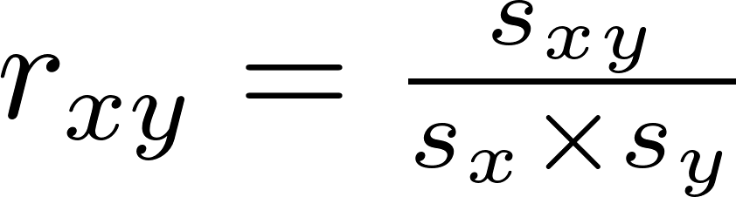
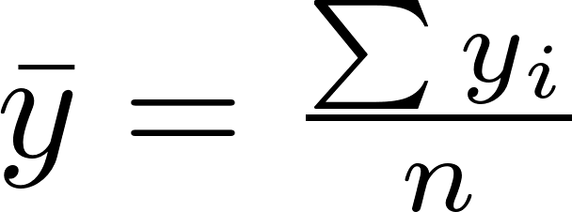
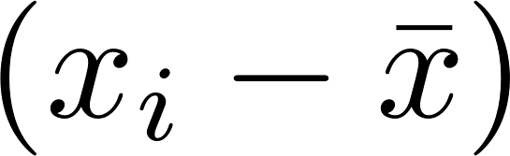
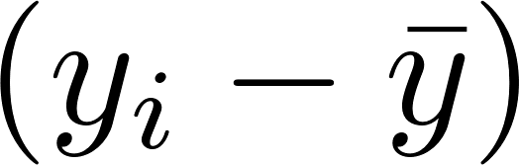
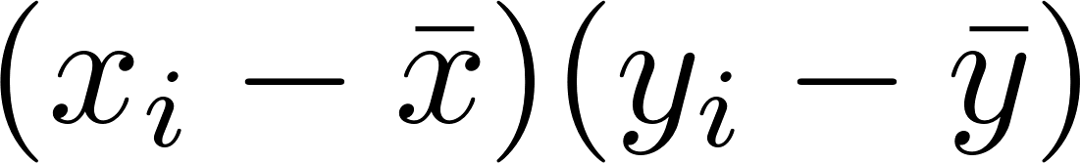
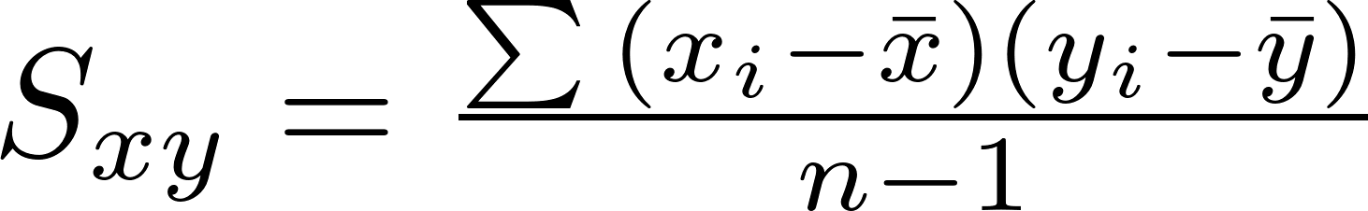
2/8/2026
Types of Data and non-graphical EDA Techniques
Covariance and Correlation
These measures assess the degree of relationship between two random variables and express the extent to which they vary together.
Correlation coefficient
Covariance
The correlation test helps determine the degree of association between two variables. This association does not imply causality. The correlation coefficient is a number between –1 and 1 that indicates the strength and direction of the relationship between variables:
1 indicates a perfect positive correlation: as one variable increases, so does the other.
0 indicates no correlation: the variables show no linear association.
–1 indicates a perfect negative correlation: as one variable increases, the other decreases.
1.
2.
3.
4.
Data analysis

Slide 20
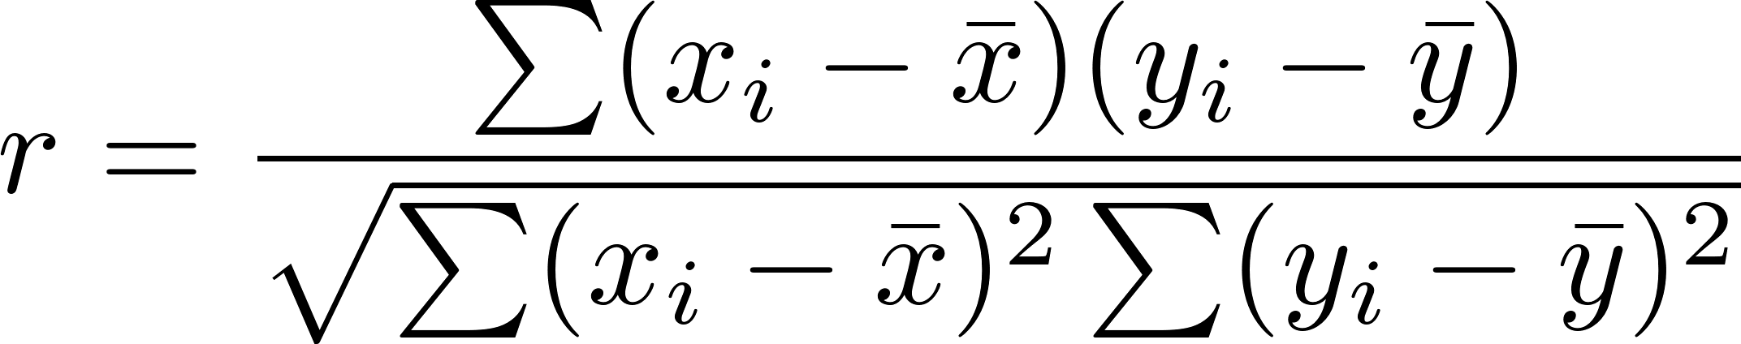
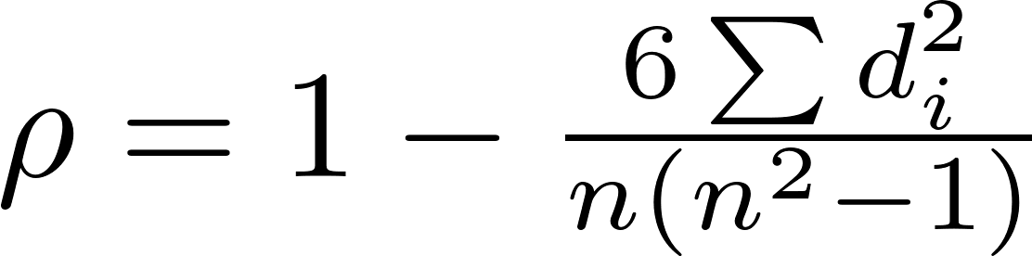
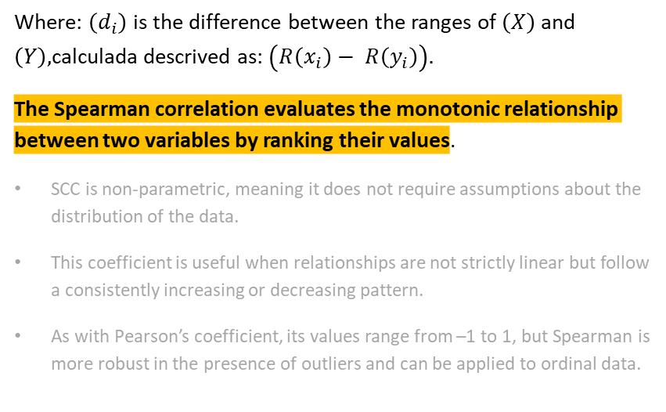
2/8/2026
Types of Data and non-graphical EDA Techniques
Pearson Correlation Coefficient
Spearman Correlation Coefficient
The Pearson correlation measures the linear relationship between two continuous quantitative variables. It evaluates how the values of both variables vary together while maintaining a proportional relationship. The coefficient ranges from –1 to 1:
Pearson’s correlation is sensitive to outliers, as these can considerably influence its value.
Where: $\left(d_{i}\right)$ is the difference between the ranges of $\left(X\right)$and $\left(Y\right),$calculada descrived as: $\left(R\left(x_{i}\right)− R\left(y_{i}\right)\right).$
The Spearman correlation evaluates the monotonic relationship between two variables by ranking their values.
SCC is non‑parametric, meaning it does not require assumptions about the distribution of the data.
This coefficient is useful when relationships are not strictly linear but follow a consistently increasing or decreasing pattern.
As with Pearson’s coefficient, its values range from –1 to 1, but Spearman is more robust in the presence of outliers and can be applied to ordinal data.
Data analysis

Slide 21

Identification of Data Types and Study Objectives
Study Objectives
Identifying the objective of the study is an extremely important aspect when planning data analysis. A vague or poorly described objective often leads to poorly executed analysis.
The study objective must clearly identify:
The study population
The outcome of interest
The covariate(s) of interest
The relevant temporal points of the study
What is intended to be done with these elements
Investing time in making the objective as specific and clear as possible often saves time in the long term.
“To evaluate the reduction in the unemployment rate within the population that has completed tertiary education in Colombia over the past five years.”
“To evaluate the impact of programmes aimed at expanding access to higher education in rural areas of Colombia, considering as the study population young people aged 17–25 from municipalities with low educational access. The outcome of interest will be the increase in enrolment and graduation rates, while covariates will include available educational infrastructure, socioeconomic status, and governmental support received. The evolution of these factors will be analysed over the past seven years.”
Métodos cuantitativos

Slide 22
2/8/2026
Data types
After specifying a clear study objective, the next step is to determine the types of data that will be used in the analysis.
Outcomes are the variables that the study aims to investigate, improve, or influence.
In the case of analyzing the impact of tertiary education on employability, the outcome would be the rate of labor market insertion
Numerical data are values that may take any numerical value within a range.
For example, graduates’ income levels would be continuous data in a study analysing the impact of education on employment.
Dependent variables
Numerical data
Categorical data
Covariates / independent variables
Covariates are variables that may influence the outcome or should be considered to avoid bias.
For instance, in assessing the impact of tertiary education on employment, covariates may include educational level attained, field of study, and region of residence.
Categorical data are values that take a limited number of categories.
Such as educational level (technical, undergraduate, postgraduate).
Numerical data
Categorical data
Data analysis

Slide 23
2/8/2026
Data types and model selection
Multinomial
Multinominal logit regression
In some cases, this framework is unsuitable, requiring the use of alternative methods
Ordered
Ordered logit regression
Categorical
Binary
Logit/probit regression
Linear probability
Numerical
Time to event
Cox proportional hazards model
Outcome variable
Continuous
Linear regression
Objective
Data structure
Count
Poisson regression
Covariates
Negative binomial regression
Proportion
Beta regression
Cross section
Time series
Panel
Repeated cross section
Data analysis

Slide 24
Linear regression
Luis Carlos Guevara
Faculty of Finance, Government and International Relations
2026-I

Slide 25
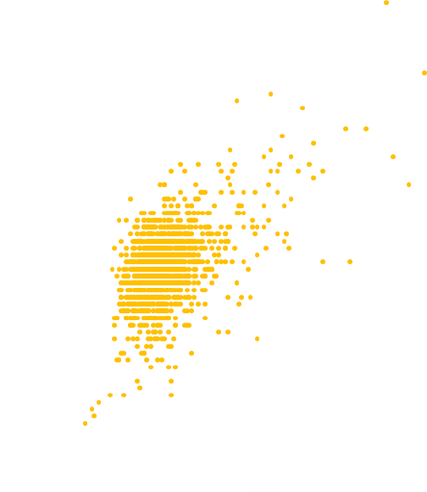

Linear regression
Linear regression provides the foundation for many analytical approaches used to study a dependent continuous variable in relation to a set of independent variables.
In the simplest case (univariate linear regression) the objective is to relate a continuous outcome to a single continuous or categorical covariate, by estimating values for β0​ and β1​ in the model:
Scatter Plot: PCO₂ and TCO₂ in a Sample of 1,776 Patients
A scatter plot of total carbon dioxide (TCO₂) (dependent variable, y‑axis) against partial pressure of carbon dioxide (PCO₂) (independent variable, x‑axis) shows that as PCO₂ increases, TCO₂ also increases.
This visual pattern suggests that a linear regression model could be appropriately fitted to describe how TCO₂ varies as a function of PCO₂.
$$y = β_{0}+ β_{1x}$$
such that the equation fits the observed data in an optimal way. The estimates ( $\hat{β_{0}}$) y ( $\hat{β_{1}}$) are distinguished from the true (often unknown) parameter values.

Slide 26
2/8/2026
Simple linear regression
Simple linear regression is used to examine the relationship between a single independent variable and a continuous dependent variable, assuming that this relationship can be adequately represented by a straight line.
“Explain y in terms of x, or study how y changes when x changes
”
Are there exact relationships between x and y?
Is there a functional relationship between x and y?
Is there a ceteris paribus relationship between x and y?
Data analysis

Slide 27
2/8/2026
Simple linear regression
Simple linear regression model
Or bivariate linear regression model
This model is assumed to hold in the population of interest, and it enables us to relate two variables: a dependent variable, an independent variable, and an error term (or disturbance) that captures unexplained variation in the relationship.
A simple regression analysis treats all factors that affect y, and which are different from x, as unobserved factors.
Systematic part of the model: the component of y that is explained by x.
Non‑systematic part of the model: the component of y that is explained by u.
is the slope parameter in the relationship between y and x, when all other factors contained in u remain constant.
Data analysis

Slide 28
2/8/2026
Simple linear regression
How to assess the relationship between the independent variable and the error term?
Correlation coefficient
Conditional expectation
$U$ and$X$are random variables.
The conditional distribution of $u$ given any value of $x$ can be defined as follows:
For each $x$, the expected value (or average) of $u$ can be obtained in the subset of the population described by that value of $x$.
Mean independence of $U$ given $X$. The average value of $u$ does not depend on the value of $x$
Conditional mean zero assumption. The average value of u does not depend on the value of x.
Data analysis

Slide 29
Simple linear regression
The wage is measured as the pesos earned per hour, and education is measured in years:therefore, β₁ measures the change in the hourly wage for each additional year of education, keeping all other factors constant.
Work experience
Innate abilities
Tenure in the current job
Work ethic
According to the assumptions about the relationship between X and U, it is required, for example, that the average level of ability be the same regardless of years of schooling.
In which cases would we expect this model to satisfy the equation ?
In an experimental context, for example, causal inference based on regression methods is developed under the assumption that when the observed variables are “made equal” in the control and treatment groups, the selection bias from factors that we cannot observe is eliminated.

Slide 30
2/8/2026
Simple linear regression
Population regression function
The average of $Y$, conditional on $X$, is a linear function of $X$:
For every one–unit increase in $X$, the expected value of $Y$ changes by the amount $β₁$.
Given any value of $X$, the distribution of $Y$is centred at $E(Y│X).$
Data analysis

Slide 31
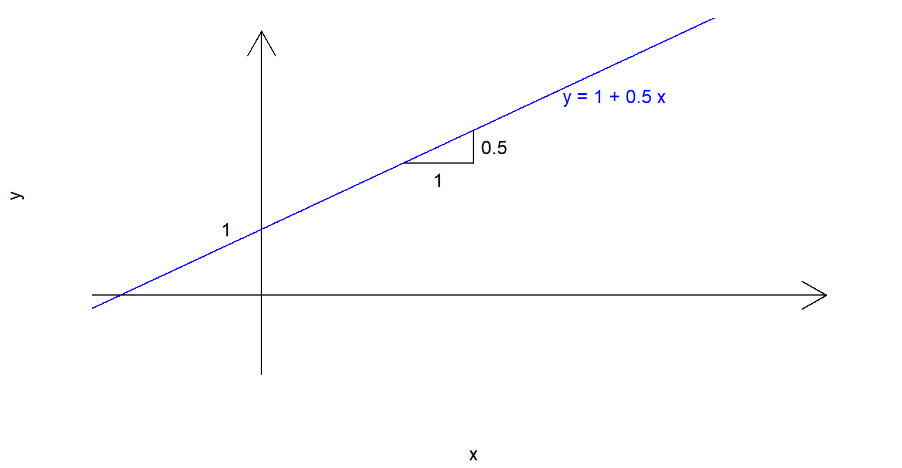
Simple linear regression
The intercept, β₀, represents the value of y when x equals 0.
The slope, β₁, represents the increase in y associated with a one‑unit increase in x.

Slide 32
Simple linear regression
Bivariate Regression and Covariance
The covariance of a variable with itself is its variance.
If the expected value of either variable is zero, then the covariance between the two variables is the expected value of their products
The covariance between linear functions of the variables of interest is given by:

Slide 33
Simple linear regression
Bivariate Regression and Covariance
The connection between regression and covariance can be observed in a bivariate regression model (with regressor X and dependent variable Y).
The slope and intercept of this regression correspond to the values of β0 and β1​ that minimise the residual sum of squares (RSS).
The term RSS refers to a sum of squares because, when performing this minimisation on a particular sample, the expectation is replaced by a sample mean or sample sum.
An implication of this is that when two variables are not correlated (i.e., have a covariance of zero), the regression of either variable on the other yields a slope coefficient equal to zero.

Slide 34
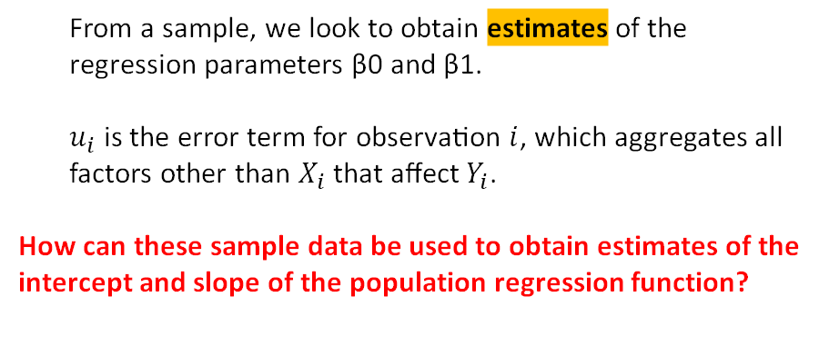
2/8/2026
Simple linear regression
Adjusted Values and Residuals: Ordinary Least Squares (OLS) Estimator
Savings
From a sample, we look to obtain estimates of the regression parameters β0​ and β1.
$u_{i}$​ is the error term for observation $i$, which aggregates all factors other than $X_{i}$​ that affect$Y_{i}$.
How can these sample data be used to obtain estimates of the intercept and slope of the population regression function?
Income
Data analysis

Slide 35
2/8/2026
Simple linear regression
Adjusted Values and Residuals: Ordinary Least Squares (OLS) Estimator
Savings
Income
Data analysis

Slide 36
2/8/2026
Simple linear regression
Adjusted Values and Residuals: Ordinary Least Squares (OLS) Estimator
Savings
Income
Data analysis

Slide 37
2/8/2026
Simple linear regression
Adjusted Values and Residuals: Ordinary Least Squares (OLS) Estimator
Savings
Income
Data analysis

Slide 38
2/8/2026
Simple linear regression
Adjusted Values and Residuals: Ordinary Least Squares (OLS) Estimator
Savings
Income
Data analysis

Slide 39
2/8/2026
Simple linear regression
Adjusted Values and Residuals: Ordinary Least Squares (OLS) Estimator
Savings
Income
Data analysis

Slide 40
2/8/2026
Simple linear regression
Adjusted Values and Residuals: Ordinary Least Squares (OLS) Estimator
Savings
Income
Data analysis

Slide 41
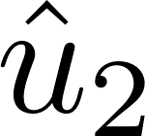
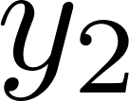
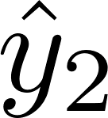
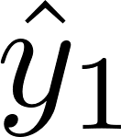


2/8/2026
Simple linear regression
Adjusted Values and Residuals: Ordinary Least Squares (OLS) Estimator
Savings
Residual
Observed value
Adjusted value
Income
Data analysis

Slide 42
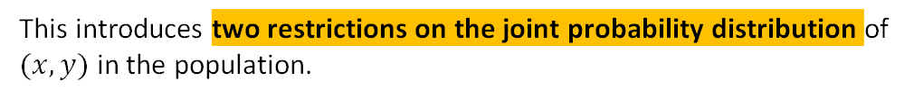
Simple linear regression
Adjusted Values and Residuals
Ordinary Least Squares (OLS) Estimates
Where do we begin?
If
Then
Under which conditions?
This introduces two restrictions on the joint probability distribution of $(x,y)$ in the population.
Data analysis
Notes:
Represente con N y n los números de elementos en la población y la muestra, respectivamente. Si el muestreo se realiza en forma tal que cada una de las N n muestras tiene igual probabilidad de ser seleccionada, se dice que el muestreo es aleatorio y que el resultado es una muestra aleatoria

Slide 43
Simple linear regression
Adjusted Values and Residuals
Ordinary Least Squares (OLS) Estimates
Where do we begin?
What are we looking for?
To choose estimates of β₀ and β₁ that solve the sample counterparts of the equations.
Under which conditions?
That is,
Data analysis

Slide 44
Simple linear regression
Adjusted Values and Residuals
Ordinary Least Squares (OLS) Estimates
Where do we begin?
What are we looking for? : β0
Under which conditions?
Data analysis

Slide 45
Simple linear regression
Adjusted Values and Residuals
Ordinary Least Squares (OLS) Estimates
Where do we begin?
What are we looking for? : β1
Under which conditions?
Data analysis

Slide 46
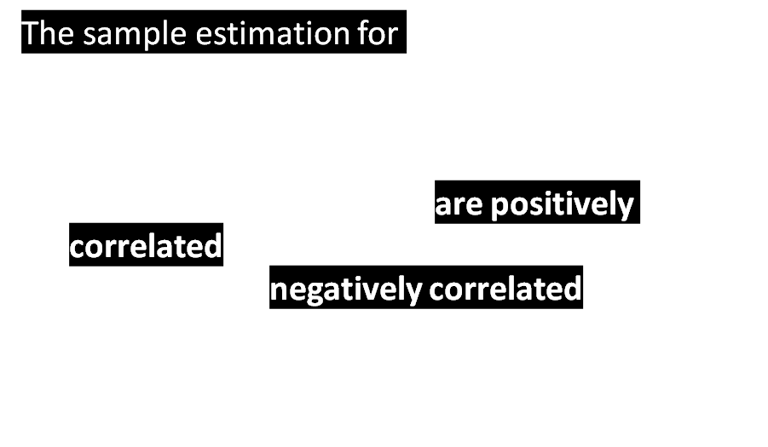
Simple linear regression
Ordinary Least Squares (OLS) Estimates
The sample estimation for $β₁$ is the sample covariance between $x$ and $y$ divided by the sample variance of $x$.
If, in the sample, $x$ and $y$ are positively correlated, then $β₁$ is positive
if $x$ and $y$ are negatively correlated, then $β₁$is negative.

Slide 47
Simple linear regression
Ordinary Least Squares (OLS) Estimates
How can we study the relationship between years of education and wages?
Variation in the hourly wage corresponding to an additional year of education.
Each additional year of education, holding all other relevant variables constant, implies an increase of $0.54 in the hourly wage.
If education is zero (no years of schooling), is the wage negative?⚠️ These may be sample effects!

Slide 48
Simple linear regression
Unbiasedness of OLS estimators
LSA1
LSA2
LSA3
LSA4
Linearity in the parameters
Random sampling
Sample variation in the explanatory variable
Zero conditional mean
Under LSA 1, 2, 3, and 4, it can be shown that the OLS estimators are unbiased.
Unbiasedness is a property of the sampling distributions of β1​ and β0​; it says nothing about the estimates obtained from any particular sample. In general, unbiasedness does not hold when any of the four assumptions is not satisfied. This is why it is very important to reflect on the truth of each assumption in the particular application being studied.

Slide 49
Simple linear regression
Unbiasedness of OLS estimators
In general, unbiasedness does not hold when any of the four assumptions is not satisfied. This is why it is very important to reflect on the truth of each assumption in the particular application being studied.
Asumption | What should we ask ourselves 🔥?
LSA1: Linearity in the parameters | Can y and x be chosen in such a way that they produce interesting non‑linear relationships?
LSA2: Random sampling | In a cross‑sectional sample, is the sample representative of the underlying population?
LSA3: Sample variation in x | Within the sample, is there variation in xxx?
LSA4: Zero conditional mean | In the relationship between y and x, might the association actually be driven by unobserved factors that affect y and that happen to be correlated with x?

Slide 50
Simple linear regression
Variance of the OLS estimators
We need to add an assumption in cross‑sectional analysis which states that the variance of the unobservable factors u, conditional on x, is constant.
LSA5
The unbiasedness of the regression estimators (which we demonstrated using assumptions RLS1 to RLS4) does not depend on the assumption of homoscedasticity.
If we assume that u and x are independent, then the distribution of u given x does not depend on x.
This allows us to see the connection between RLS4 and RLS5.
Here we have a problem: the assumption of conditional mean independence can be very strong and difficult to justify.
Homoscedasticity
LSA4
LSA5

Slide 51
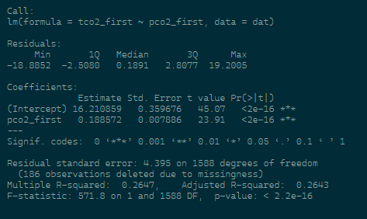
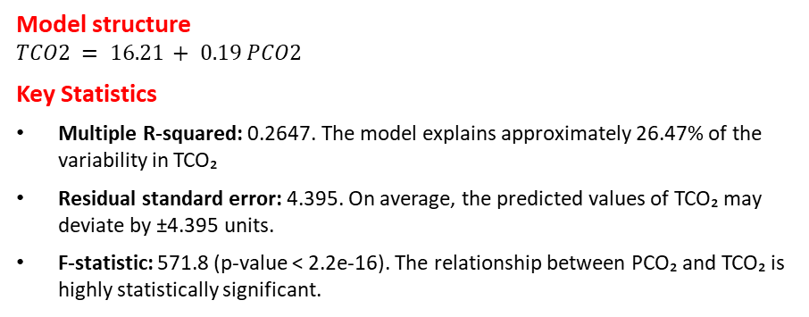
2/8/2026
Simple linear regression
Results of the Linear Regression Model
Model structure
$$TCO2 = 16.21 + 0.19 PCO2$$
Key Statistics
Multiple R‑squared: 0.2647. The model explains approximately 26.47% of the variability in TCO₂
Residual standard error: 4.395. On average, the predicted values of TCO₂ may deviate by ±4.395 units.
F‑statistic: 571.8 (p‑value < 2.2e‑16). The relationship between PCO₂ and TCO₂ is highly statistically significant.

Slide 52

2/8/2026
Simple linear regression
Results of the Linear Regression Model
Estimated Intercept ($\hat{β_{0}}$): This indicates the predicted level of TCO₂ for an individual with a PCO₂ value of 0. This interpretation is purely mathematical, and such a quantity often has limited practical use.
Estimated Slope ($\hat{β_{1}}$): This can be interpreted as the rate at which the predicted value of TCO₂ increases for each one‑unit rise in PCO₂. In this case, it is estimated that TCO₂ increases by approximately 0.189 mmol/L (millimoles per litre) for every 1 mmHg (millimetre of mercury) increase in PCO₂.
Standard Error: This is a measure of the degree of certainty associated with the estimate. If the standard error is large relative to the coefficient, the estimate is less reliable. Many factors can influence the magnitude of the standard error, including the sample size.
t‑value: This is simply the estimated coefficient divided by its standard error.
Pr(>|t|) or p‑value: This is a measure of statistical significance. Along with the t‑statistic, it is linked to hypothesis testing conducted within the model framework.

